Slide 1
Singapore
Waste
Management

Slide 2
Contents
1)Introduction
2)Waste Management System
3)Waste Management Strategies
4)Waste Generation
5)Recycling
6)Incineration
7)Landfill
8)Future
9)Conclusion

Slide 3
Introduction - Singapore
Island Nation
City-State
Land Area
722.5 km2
Population
5.69 mil
(7861 pp/km2)
Limited Natural Resources

Slide 4
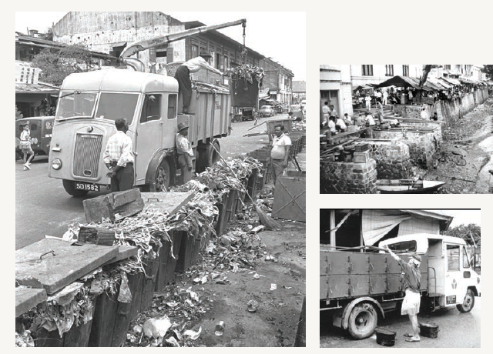
Before:
No Proper System

Slide 5
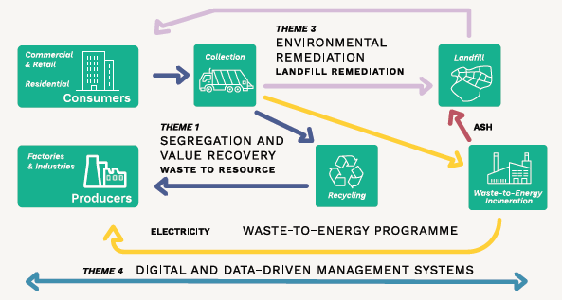
Current Waste Management System

Slide 6
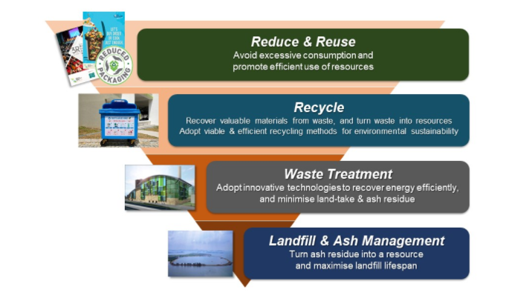
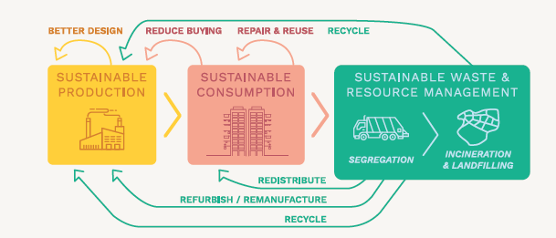
Waste Management Strategies Waste Minimisation, Recycling, Sustainabiliy & Closing the Waste loop by adapting Circular Economy Approach

Slide 7
Current Waste Management System

Slide 8
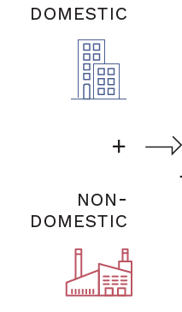
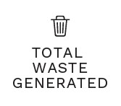
Waste Generation Domestic & Non-Domestic Waste
On an Average every year, approx. Domestic Waste is 25% & Non-Domestic Waste is 75%

Slide 9
Waste Generation Vs Population

Slide 10
Waste generated Data:

Slide 11
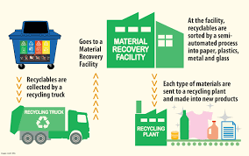
Recycling

Slide 12
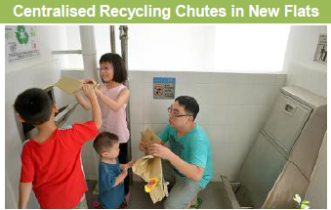

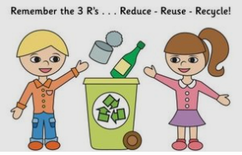
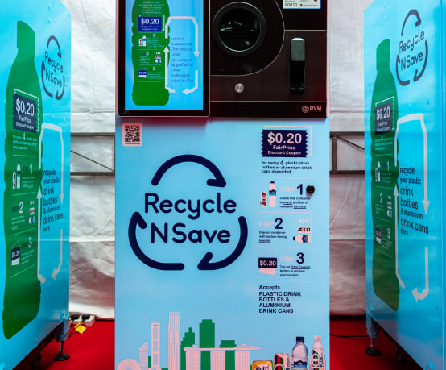
Recycling Initiatives:
National Recycling Programme
Mandatory Waste Reporting
Brochures, flyers, guides to public
Awareness programmes at schools
3R Awards , 3R Funds
Reverse Vending Machine –Incentives
Centralised Recycling Chutes

Slide 13
Recycling(Categorised) – Year 2019
We have to work on
Plastic, Food, Sludge,
Textile, Glass wastes

Slide 14
Recycling Rate
2019

Slide 15

Focusing on Three Priority waste Streams
1)Food Waste
2)E-Waste
3)Plastic & Packaging waste

Slide 16
Food Waste
Happens at 1)Production 2)Distribution 3)Retail 4)Consumption
2019 - Ard 750,000 Tonnes of Food Waste generated, only 15% Recycled, 85% Landfill
Recycling rate up from 8% to 15% from Year 2000 to 2019
Govt is coming up with lots of initiative to improve food waste recycling

Slide 17
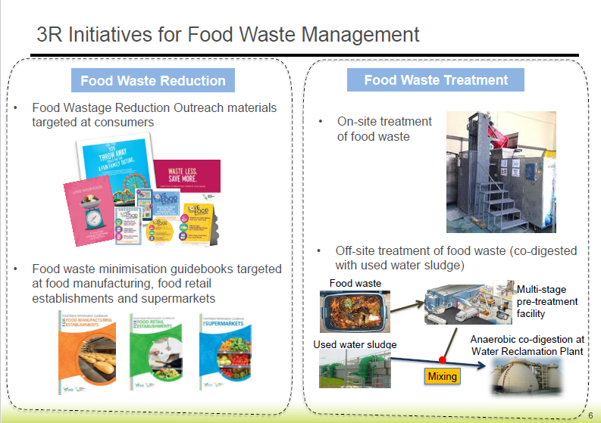

Slide 18

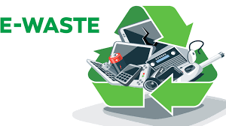
E-Waste
Electrical & electronic waste (e-waste) makes up ard 1% of total waste generated in Singapore
Around 60,000 to 70,000 Tonnes generated per year
Equals 11kg of disposal per person per year
Can cause detrimental effect on the environment if not properly managed
Great potential for the circular economy approach as can recover materials from e-waste

Slide 19
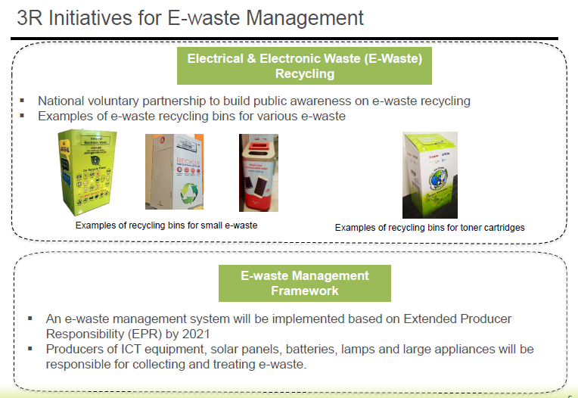

Slide 20
Plastic & Packaging Waste
In 2018, 1/3rd of domestic waste
disposed consisted packaging waste.
Packaging waste – 55% plastic packaging
& 25% paper packaging.
Able to recycle only 6% of plastic waste
generated in year 2019
Recycling rate decreasing
Reduce Plastic Consumption
Plastic alternatives

Slide 21
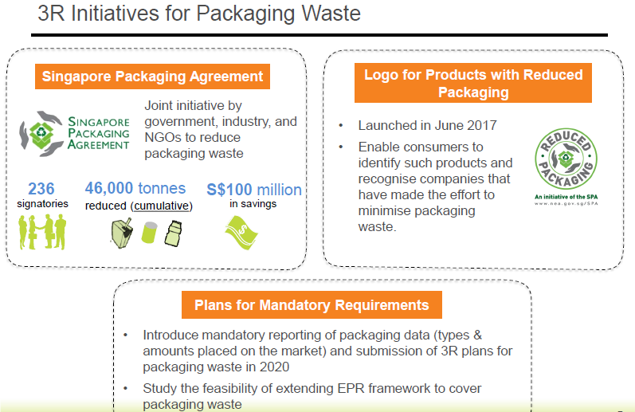

Slide 22
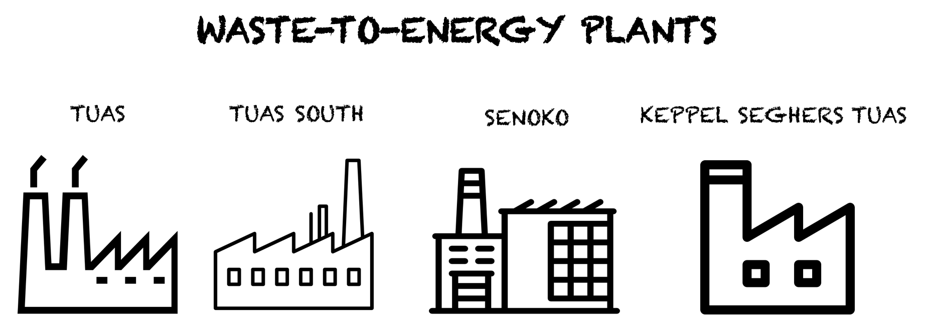
Incineration(Trash to Ash)
A waste treatment process, where the waste materials are burned to ashes.
Waste volume reduces by 90% in the process
Ash(End product) sent to Landfill for disposal
Energy(electricity) is produced from the heat generated.
Advanced combustion system - Waste is completely burnt, metals recovered
Harmful gases are removed.
Singapore’s first Waste-To-Energy Plant opened in 1979.
Ash being used as construction material(under field trial)

Slide 23
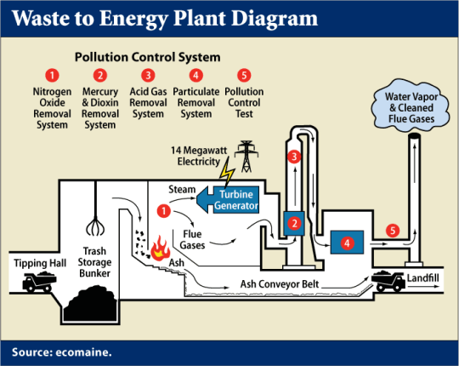
Waste-To-Energy Plants
Waste Incinerated is slowly decreasing from 53% in 2000 to 38% in 2019.

Slide 24
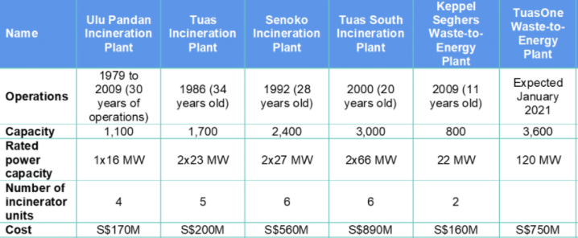
Waste-To-Energy Plants

Slide 25
Non Incinerable waste - List
1.Big appliances such as washing machines, refrigerators and air-conditioning units.
2. Big metal pieces such as large drums or containers, vehicular parts, metal chairs, wire rope and spring mattress.
3. Bulky waste that consists of any of the following: a. a solid object exceeding 0.6 m in length or width or 0.1 m in thickness; b. a hollow object exceeding 0.6 m in length, width or height.
4. Carbon fibres.
5. Chlorinated herbicides, chlorinated insecticides and chlorinated fungicides.
6. Chemical waste with chemical content which is unsuitable for incineration.
7. Explosive or highly flammable waste such as ammunition, dry and wet carbide waste, fireworks, self-igniting waste and excessive quantities of films.
8. Fire retardants.
9. Human and animal waste, sludge from neutralisation pits, foul-smelling waste and large whole animal carcasses.
10. Insulation materials such as rock wool, asbestos, calcium silicate boards, ceramic fibres and big carpets.
11. Large quantities of electrical parts and components such as printed circuit boards, cables and electronic cards. 12. Light materials such as sawdust, feathers, dust and powders.
13. Liquid and volatile waste, oil sludge and paints.
14. Poisonous and radioactive waste.
15. Polychlorinated compounds such as Polychlorinated Bi-phenyl (PCB).
16. Polyvinyl Chloride (PVC) waste such as PVC pipes, plastic film, upholstery, containers and packaging materials.
17. Smouldering refuse.
18. Toxic industrial waste specified in the Schedule to the Environmental Public Health (Toxic Industrial Waste) Regulations (Rg 11).
19. Tyres.
20. Construction and renovation debris, earth, concrete, stone, sand, sludge, ash and slag.
21. Waste from grease interceptors.
22. Waste from sewerage systems, including waste from sewage treatment plants, septic tanks and water-seal latrines.
23. Waste from sanitary conveniences not part of a sewerage system, including waste from sanitary conveniences which are mobile or in ships or aircraft.

Slide 26

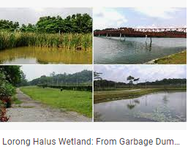
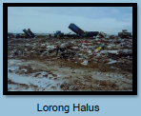
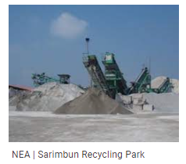
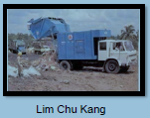
Landfills
Non Incinerable wastes are directly sent to Landfills
1)Lim chu Kang (closed) – 1976 to 1992 Transformed into Sarimbun Recycle park
2)Lorong Halus (closed) – 1970 to 1999, Transformed into Lorong Halus wetland
3)Semakau Island – “The Island of Trash”

Slide 27

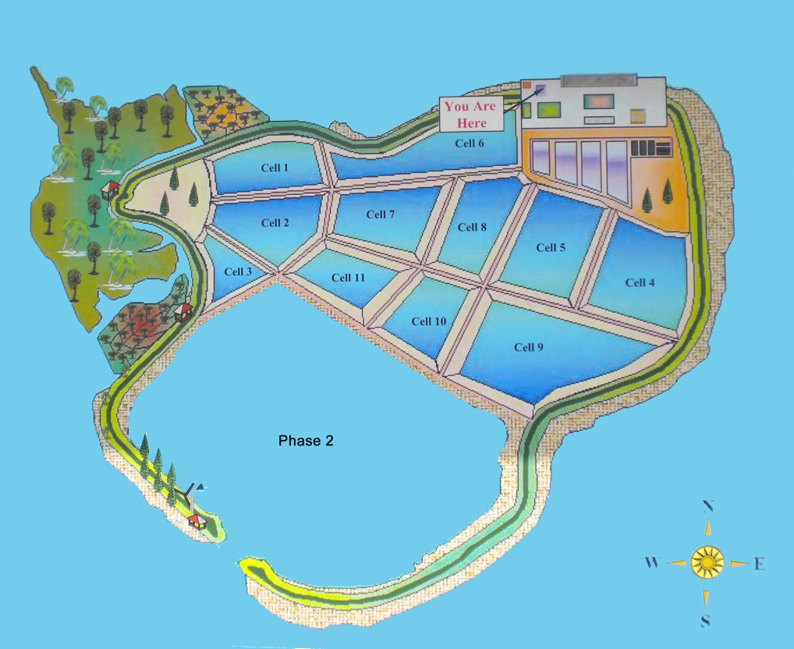
Semakau Island World’s first Man- made offshore landfill created entirely out of sea space
Commenced :1 April 1999
Cost : $610m (Phase I 1999) , $36m (phase II in 2015)
Total Area : 350 ha
Total Capacity : 63 million cu m
Capacity left : 28 million cu m
Expected Lifespan : Until 2035 (14 years left)
Daily Landfill : 2100tons waste(1500t ash + 600t n.incwaste)
Open to Public and monthly guided tours are conducted.
www.nea.gov.sg/media/news/news/index/celebrating-20-years-of-semakau-landfill

Slide 28
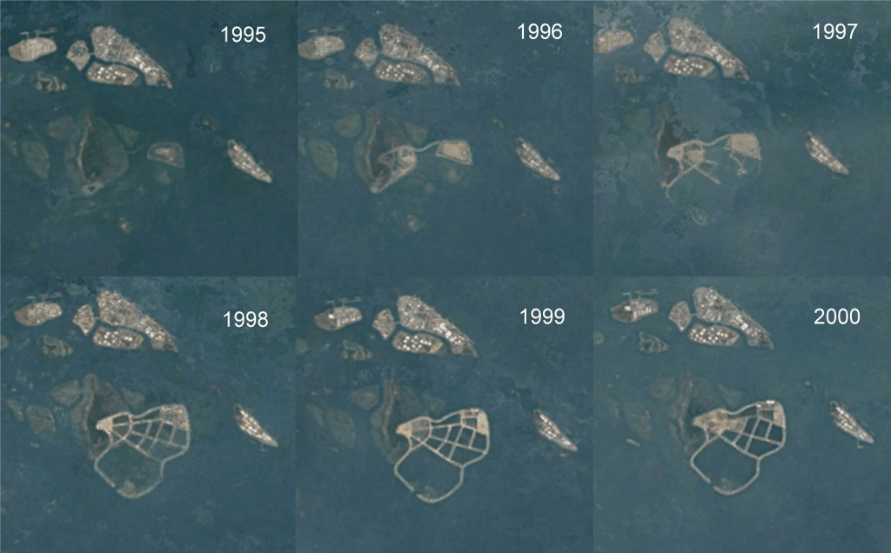
Semakau Transformation Aerial View

Slide 29
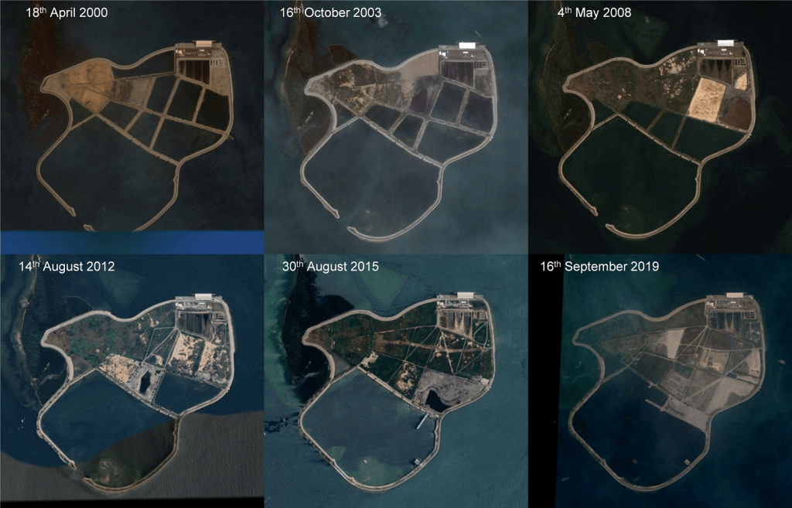

Slide 30
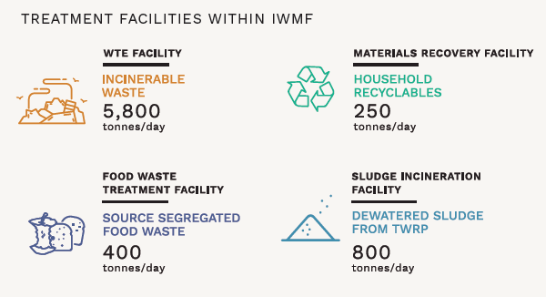
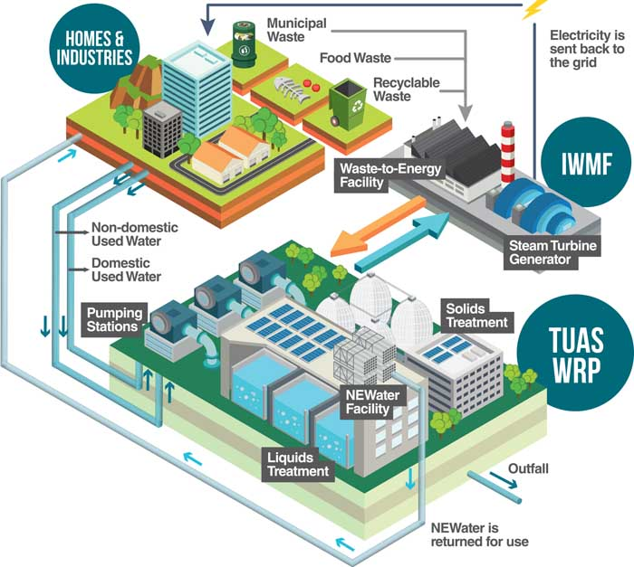
Future: Integrated Waste Management Facility
First of its kind and a one stop place
Integrated solid waste and used water treatment under one roof
Phase I – 2024 , Phase II – 2027

Slide 31
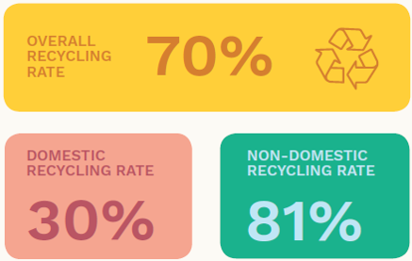
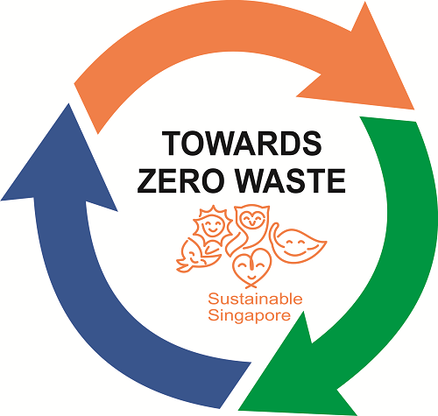
Target : Towards Zero Waste Singapore Year 2030 Target
Year 2019
Overall Recycling Rate - 59%
Domestic Recycling - 17%
Non-Domestic - 73%

Slide 32
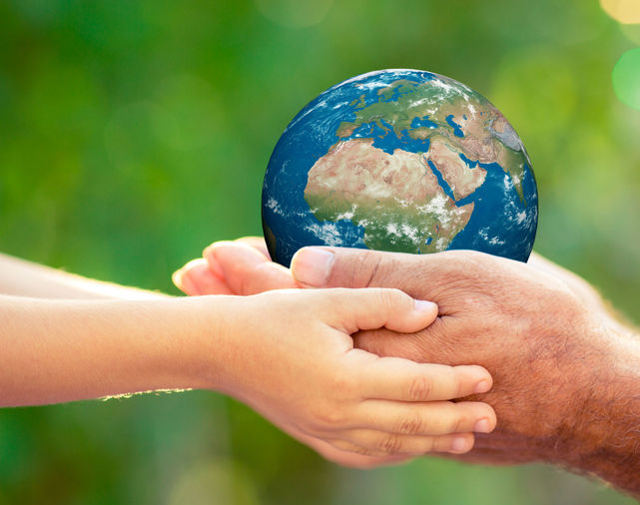

Conclusion
Towards the goal Zero waste Sg
Minimize waste & Recycle more
Provide a Clean & healthy environment to our Future Generation

